Slide 1
Tuesday 2nd March, 2021
LI – Can I identify the different food groups?
English - sentence writing

Slide 2
This is the food pyramid
It shows how much of each food group adults should eat.
We should eat the most from the carbohydrates group at the bottom and the least from the fats and sugars group at the top.
In order to eat a balanced diet, we should eat foods from each of the groups

Slide 3
Split a piece of paper into 6 and label these sub-headings
Carbohydrates | Proteins | Milk and dairy
Fruits | Vegetables | Fats and Sugars
As you go through the powerpoint, make a note about what each food group does within your body and draw a couple of example foods in each box.

Slide 4
Carbohydrates
Starchy foods give us slow release energy.
E.G bread, rice, pasta and cereals
These will keep you filled up for longer and slowly release into your body throughout the day.

Slide 5
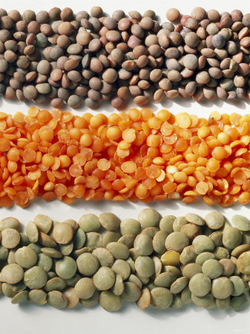
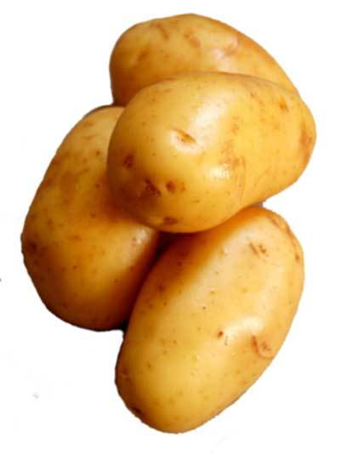
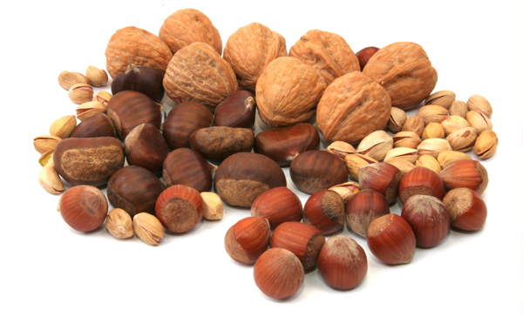
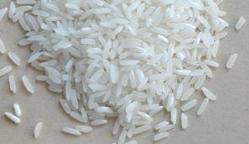
These foods are all a good source of carbohydrates
potatoes
bread
pulses, lentis,
beans
nuts
rice

Slide 6
Proteins…
Help our bodies grow and repair themselves.
Without protein, you won’t have a strong body because your muscles won’t develop. You’ll also take longer to heal when you injure yourself…
People who eat meat get lots of proteins from the meat that they eat. Vegetarians need to eat nuts and things like quorn to give them protein.

Slide 7
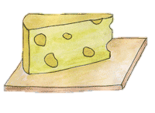
Dairy…
Dairy provides calcium.
Your body needs calcium to help keep bones and teeth strong and healthy. Be careful though… some of dairy like ice-cream and cheese is high in fat, so you shouldn’t eat too much!

Slide 8
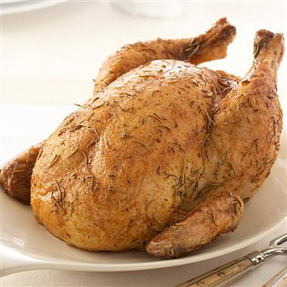
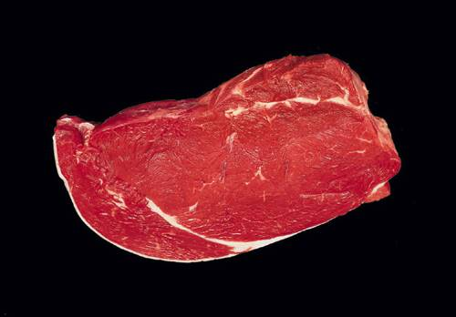
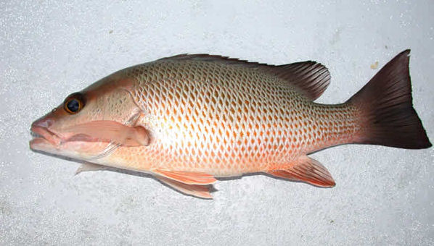
These foods are all a good source of protein and dairy
eggs
chicken
cheese
milk
meat
fish
yoghurt

Slide 9
Fruit and Vegetables…
They help your body to work properly.
Fruit and vegetables provide fibre, minerals and vitamins.
If you don’t eat enough fibre, it can become difficult to go for a poo. Vitamins help keep you fit and healthy- they create an army which can fight off bugs and bacteria.
Adults should eat at least 5 portions of fruit and veg each day…

Slide 10
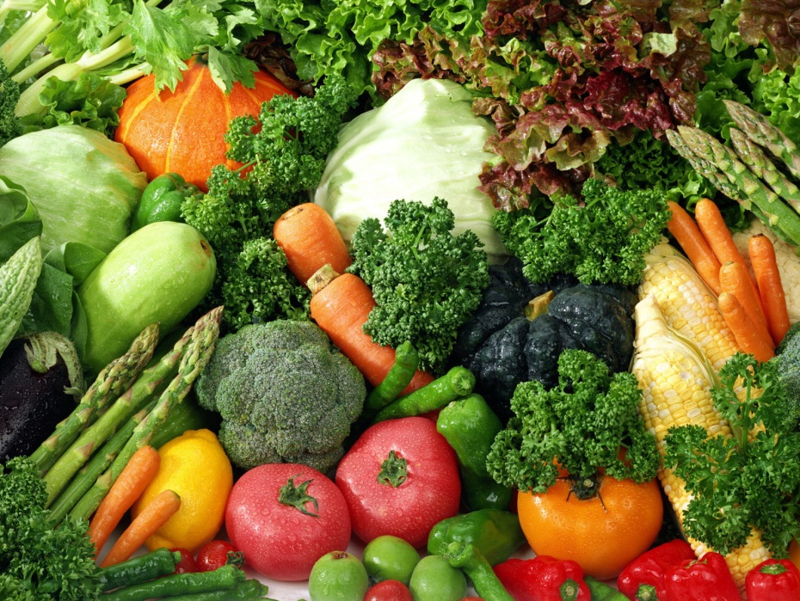
These foods are a good source of fruits and vegetables
vegetables
fruit

Slide 11
Fats and sugars…
Fats and sugars help provide energy.
Our bodies are really clever, and store the spare energy from fats until your body needs it, but you shouldn’t eat too many fats! Sugars provide short bursts of energy, which don’t last for
very long and might make you a little
hyperactive!

Slide 12
These foods are a source of fats and sugars
sugar
honey
chocolate
cake

Slide 13
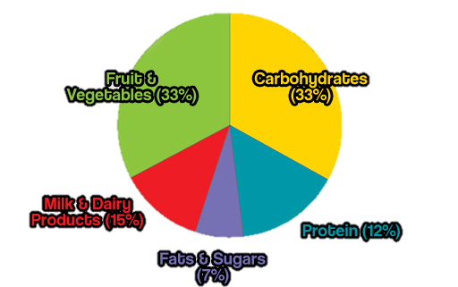
So how much should you eat?
This plate shows you how much of each food group you should eat each day…

Slide 14
English lesson - Tuesday
Can I write sentences about different food groups?
Carbohydrates proteins
Milk and diary fats and sugars
Fruit and vegetables

Slide 15
Using your notes from earlier, explain what each food group does and give some examples of foods in it.
Make each one a new sub-heading
Here’s some notes to remind you.
Carbohydrates – provide slow release energy, fills us up (bread, pasta, rice)
Proteins – helps to grow and repair your body (meat, eggs, quorn, nuts)
Dairy and milk – calcium helps to make our bones and teeth grow and stay healthy. (milk, cheese, yogurt)
Fruit and vegetables – Gives us fibre, vitamins and minerals, need 5 portions and helps to keep our bodies healthy and regular. (carrots, tomatoes)
Fats and sugars – provide quick release energy, don’t eat too much (sweets, cakes, biscuits, chocolate)

