Slide 1

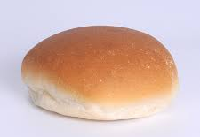
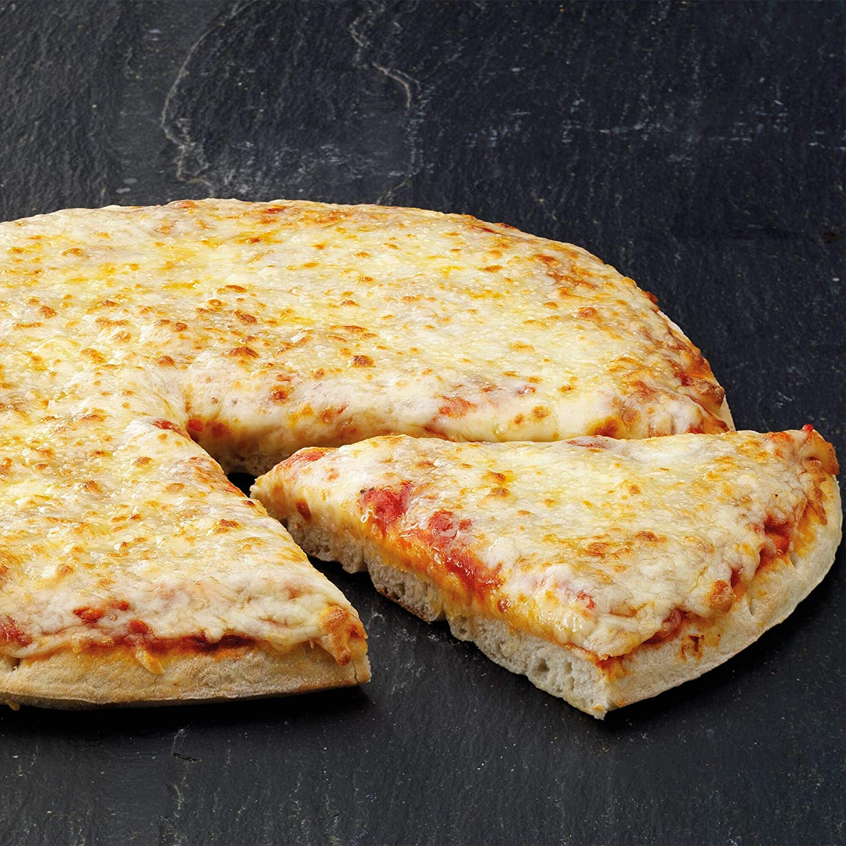
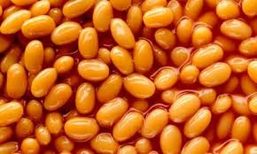
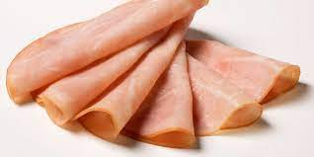
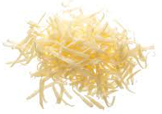
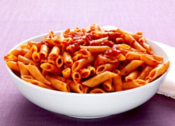
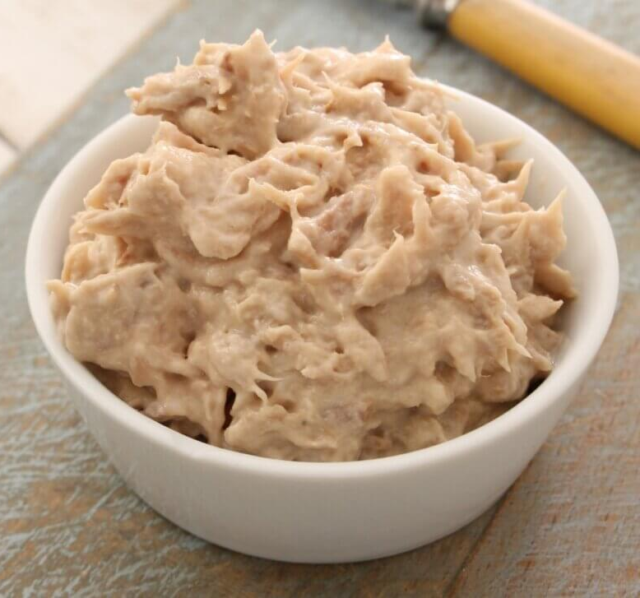
Week 1: Monday
Red: Margherita or Pepper Pizza
Green: Italian Tomato Pasta
Jacket Potato
Roll
Beans, cheese or tuna
Ham, cheese or tuna

Slide 2
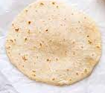
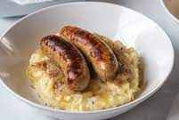
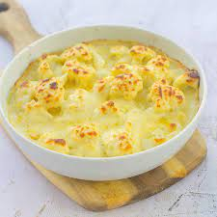
Week 1: Tuesday
Red: Oven Baked Sausages
Green: Cauliflower Cheese Loaded
Yorkshire Puddings
Jacket Potato
Wrap
Beans, cheese or tuna
Ham, cheese or tuna

Slide 3
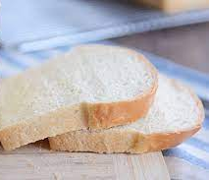
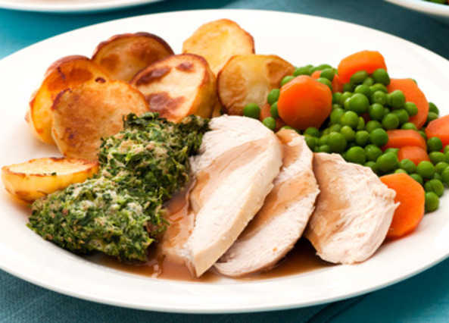
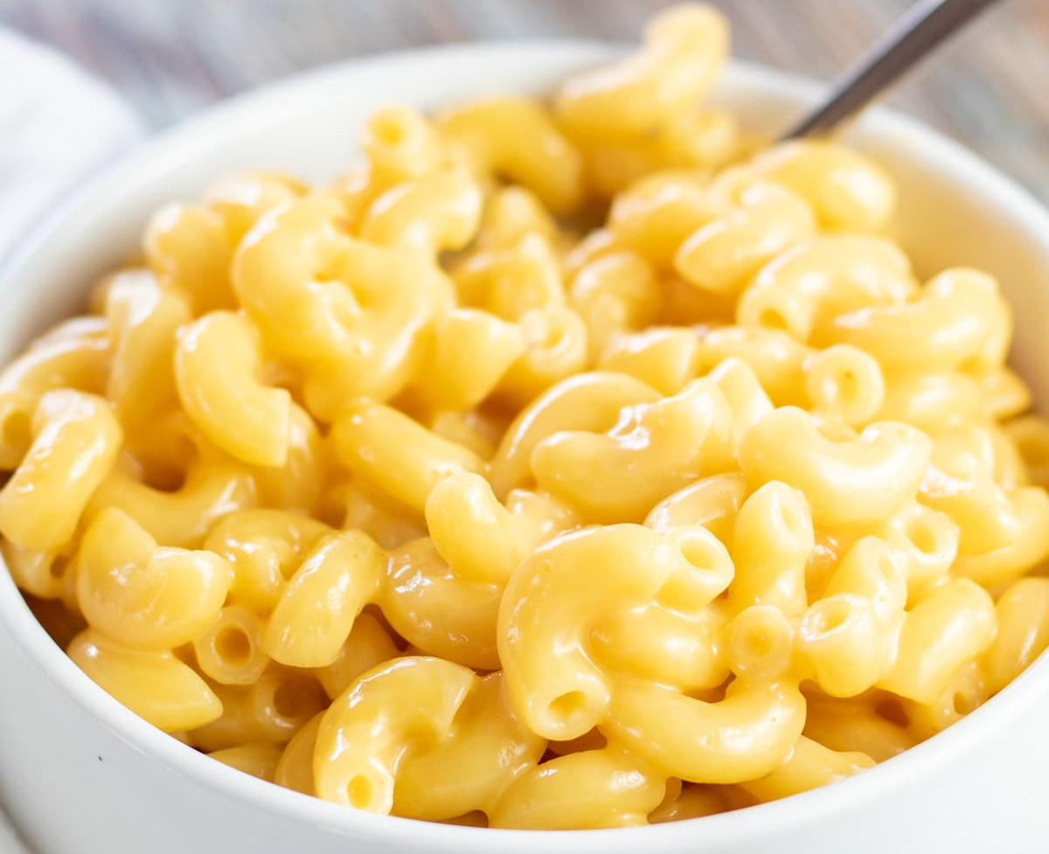
Week 1: Wednesday
Red: Roast Chicken
Green: Cheesy Pasta
Jacket Potato
Sandwich
Beans, cheese or tuna
Ham, cheese or tuna

Slide 4
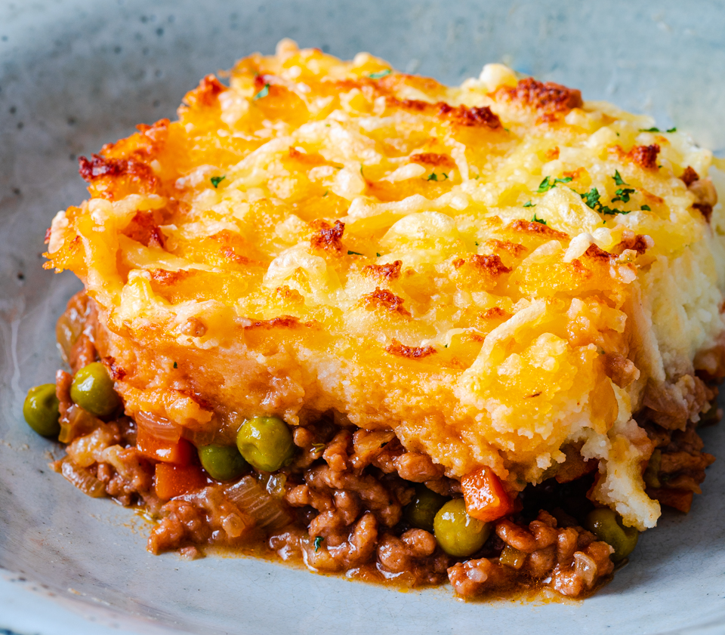
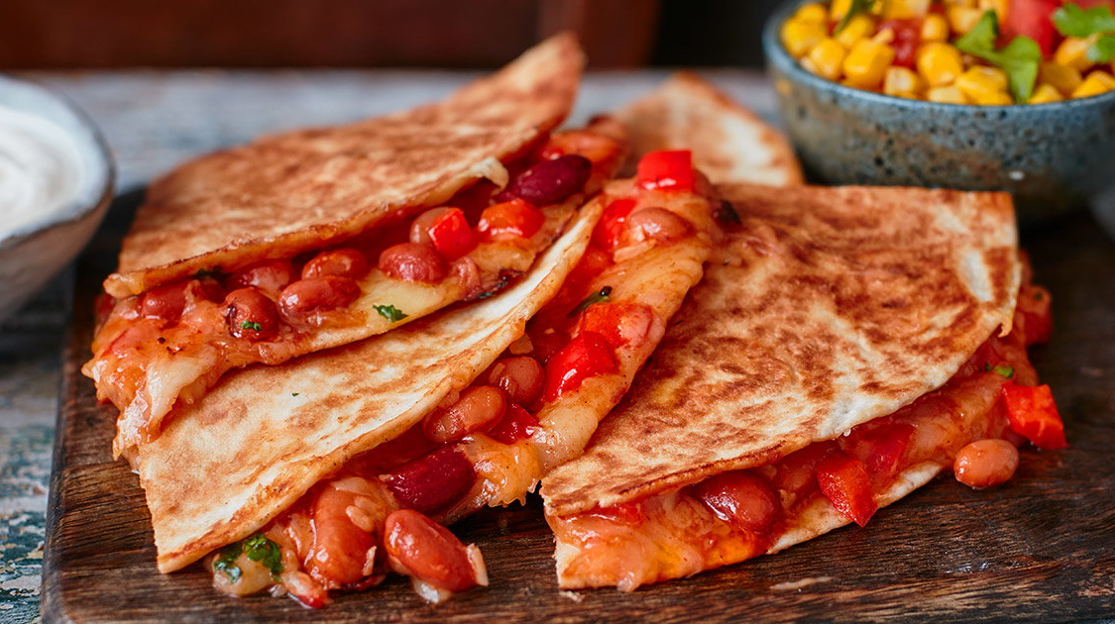
Week 1: Thursday
Red: Cottage Pie
Green: Baked Bean Quesadilla
Jacket Potato
Roll
Beans, cheese or tuna
Ham, cheese or tuna

Slide 5
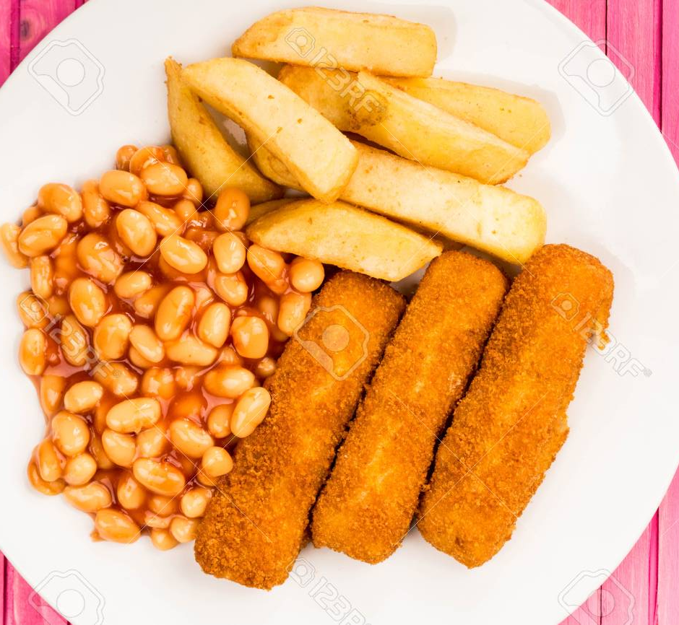
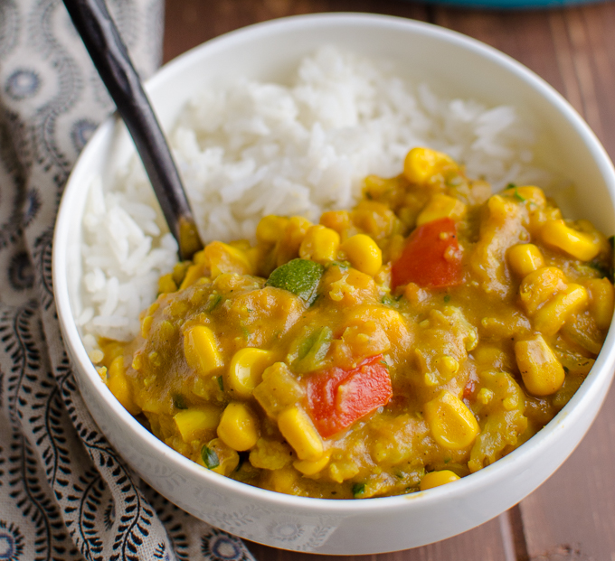
Week 1: Friday
Red: Fish Fingers
Green: Vegetable Curry
Jacket Potato
Sandwich
Beans, cheese or tuna
Cheese or tuna

Slide 6
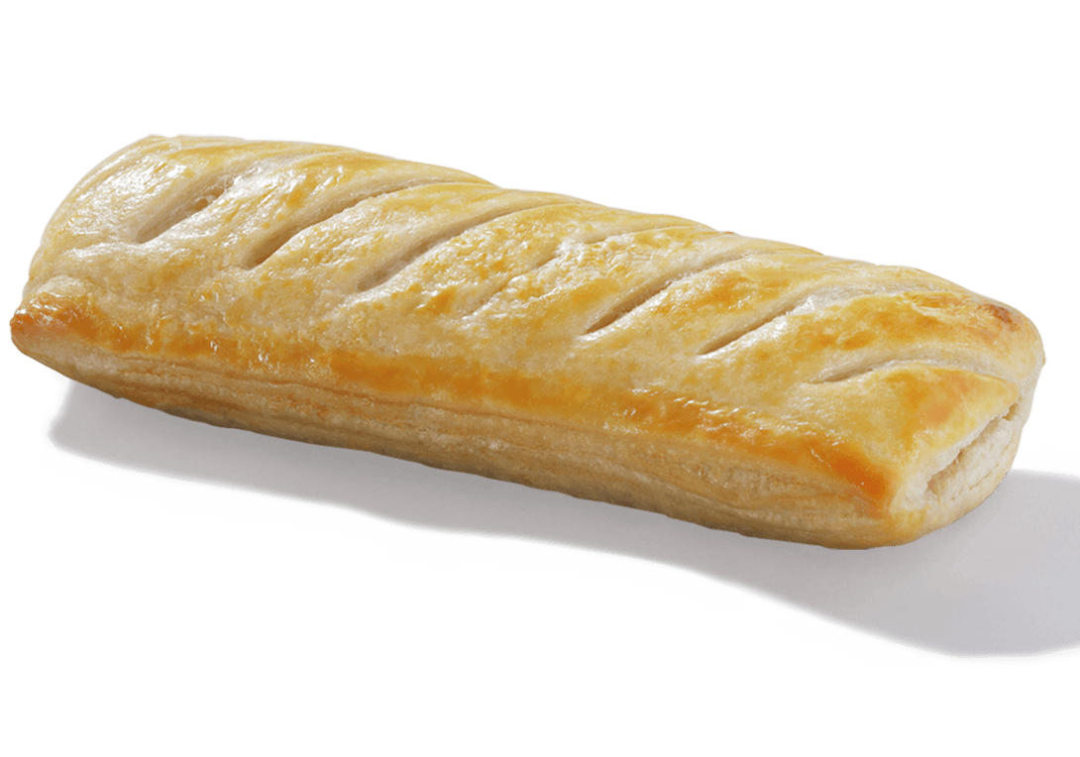
Week 2: Monday
Red: Margherita or Pineapple Pizza
Green: Vegan Sausage Roll
Jacket Potato
Sandwich
Beans, cheese or tuna
Ham, cheese or tuna

Slide 7
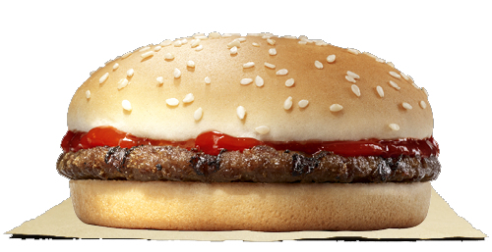
Week 2: Tuesday
Red: The Dolce Burger
Green: Pasta Neapolitan
Jacket Potato
Roll
Beans, cheese or tuna
Ham, cheese or tuna

Slide 8
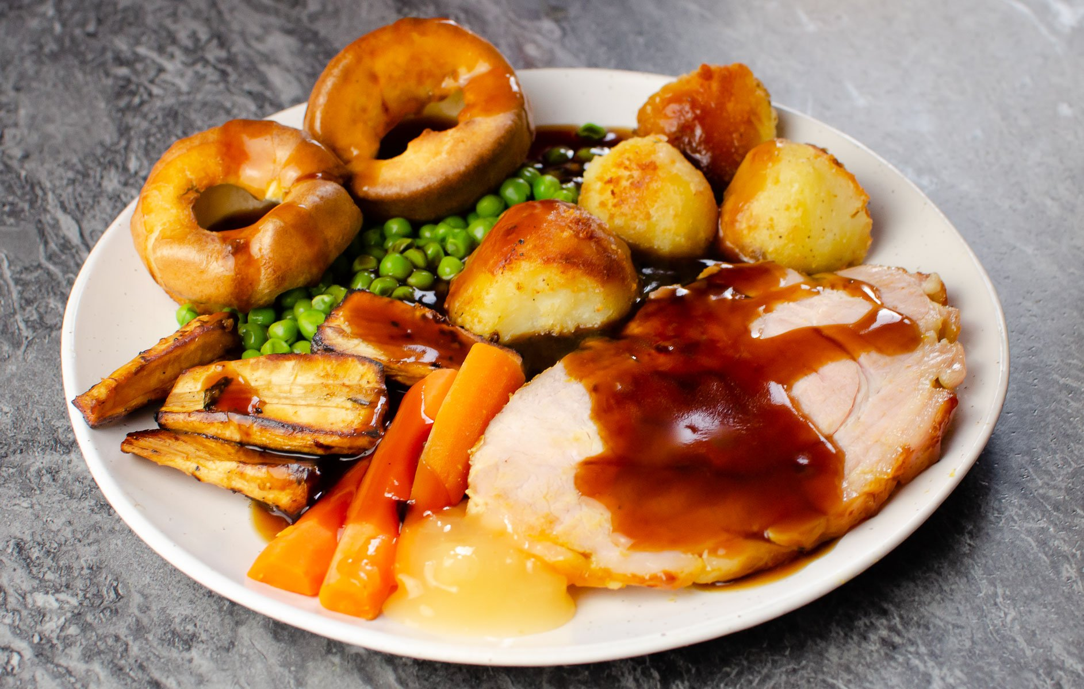
Week 2: Wednesday
Red: Gammon
Green: Macaroni Cheese
Jacket Potato
Sandwich
Beans, cheese or tuna
Ham, cheese or tuna

Slide 9
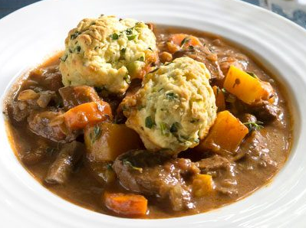
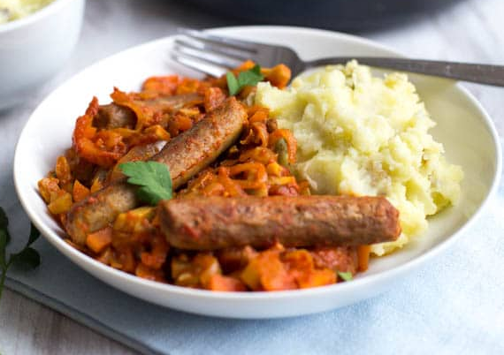
Week 2: Thursday
Red: Beef Exeter
Green: Vegetable Sausage Casserole
Jacket Potato
Wrap
Beans, cheese or tuna
Ham, cheese or tuna

Slide 10
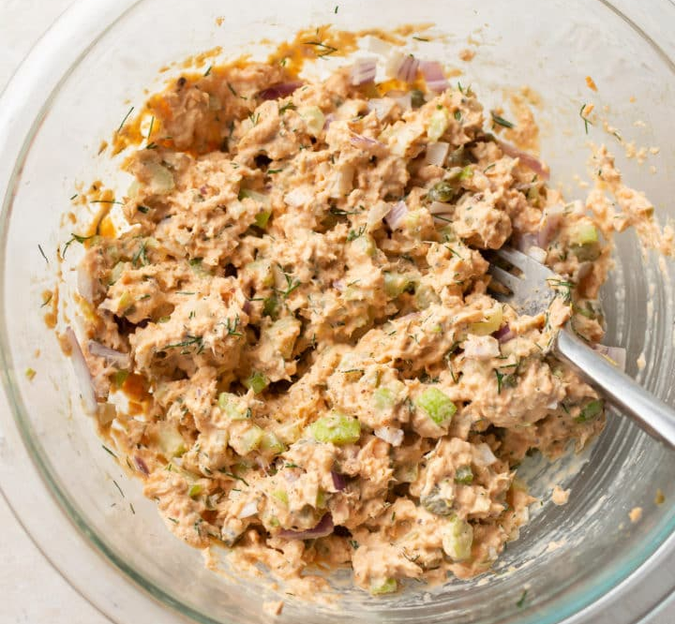
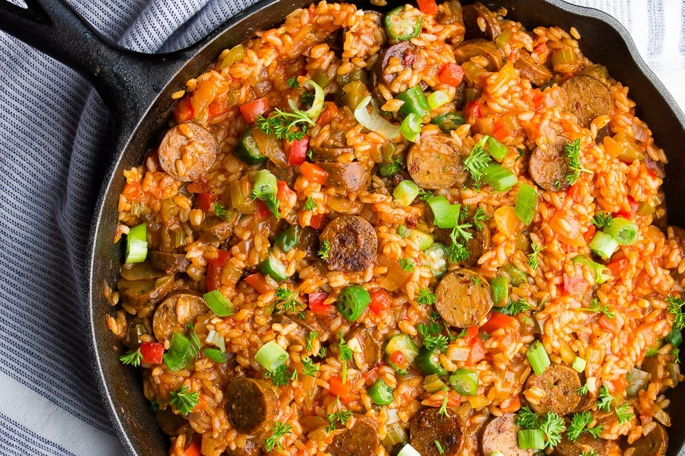
Week 2: Friday
Red: Fish Fingers
Green: Plant Based Jambalaya
Jacket Potato
Roll
Beans, cheese or tuna
Salmon, cheese or tuna

Slide 11
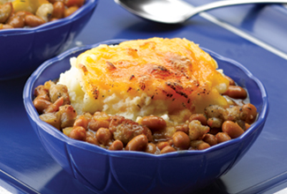
Week 3: Monday
Red: Margherita or Sweetcorn Pizza
Green: Baked Bean and Potato Pie
Jacket Potato
Wrap
Beans, cheese or tuna
Ham, cheese or tuna

Slide 12
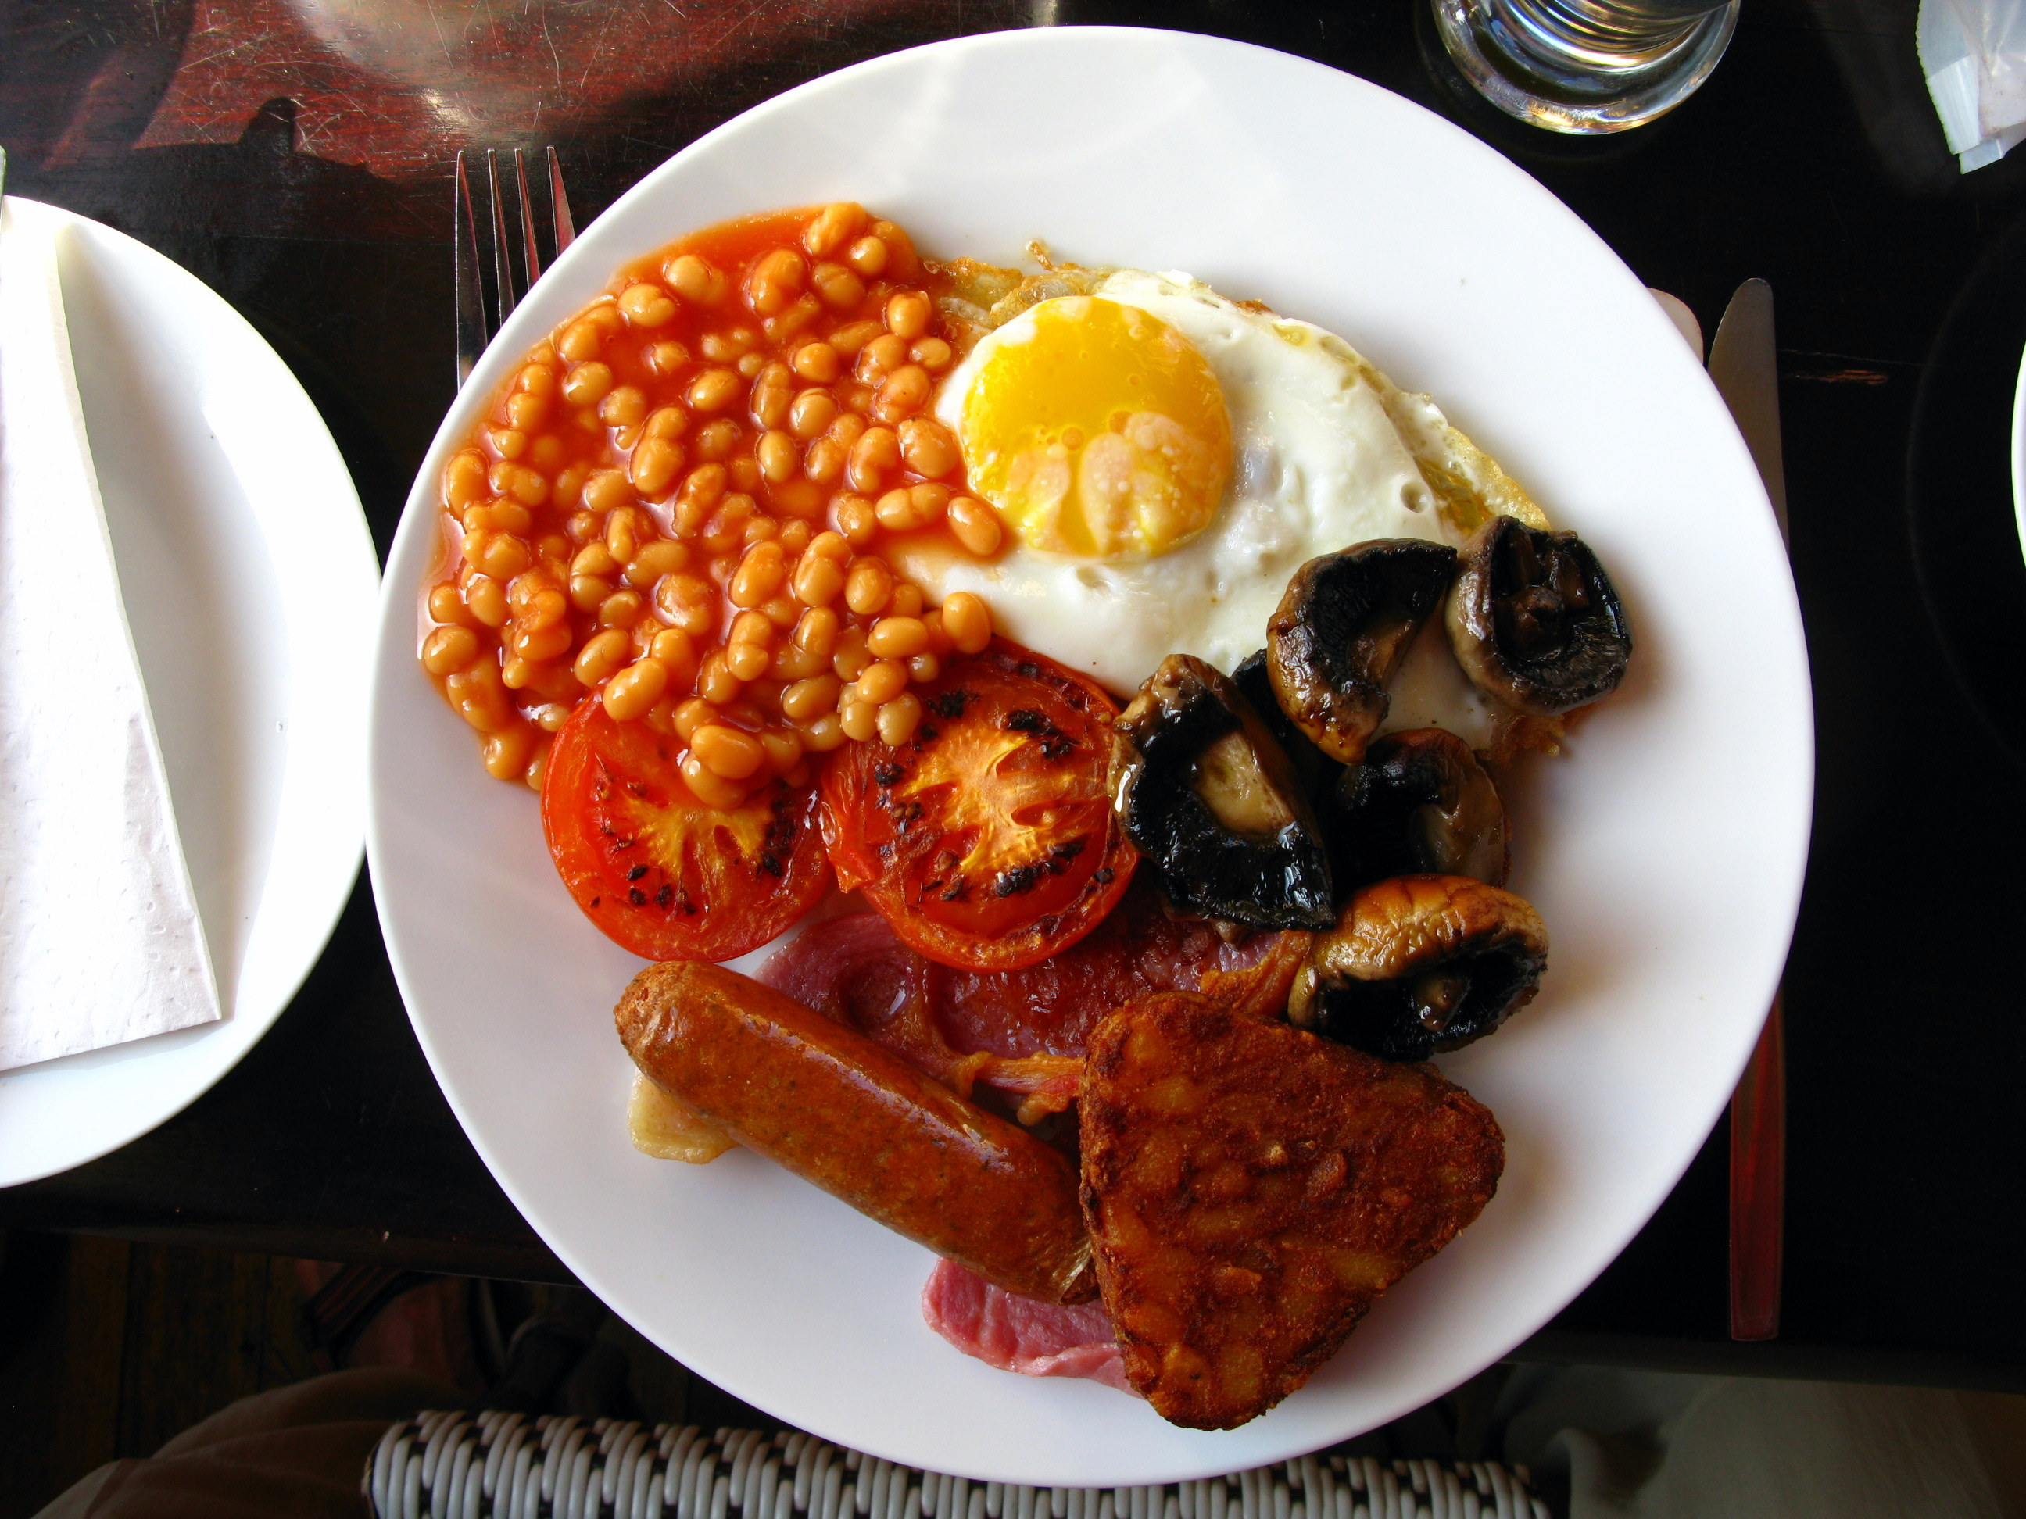
Week 3: Tuesday
Red: All Day Breakfast
Green: Italian Tomato Pasta
Jacket Potato
Roll
Beans, cheese or tuna
Ham, cheese or tuna

Slide 13
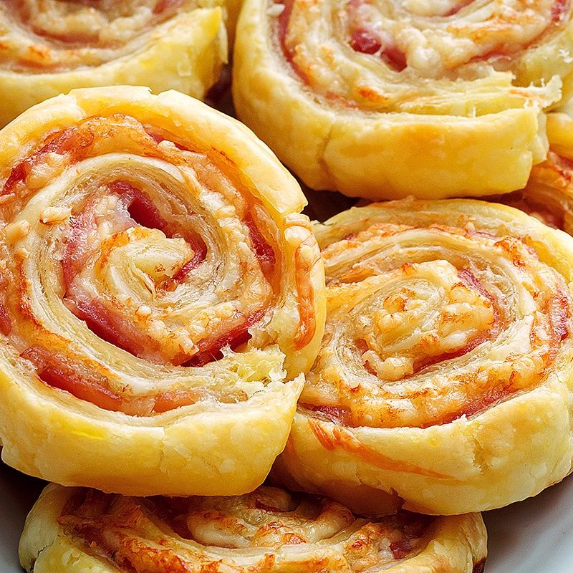
Week 3: Wednesday
Red: Roast Chicken
Green: Cheese and Tomato Pin Wheel
Jacket Potato
Sandwich
Beans, cheese or tuna
Ham, cheese or tuna

Slide 14
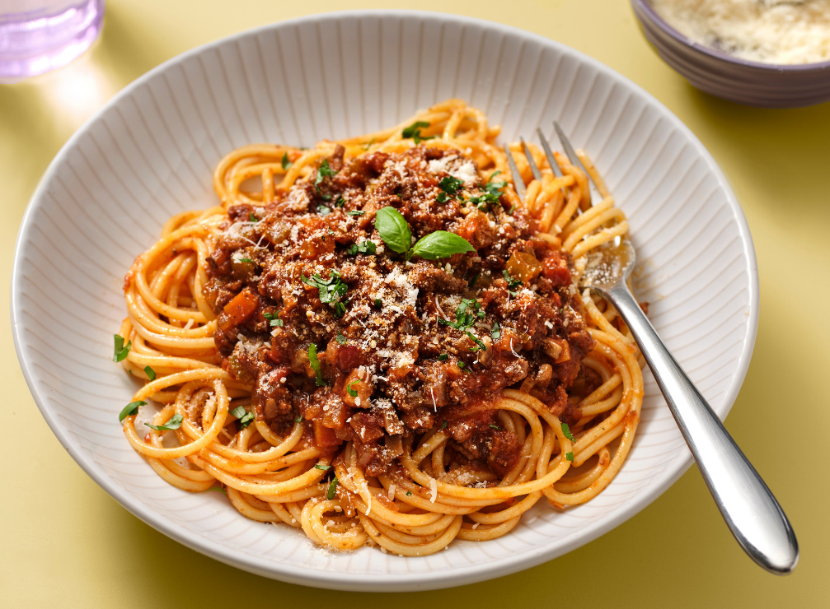
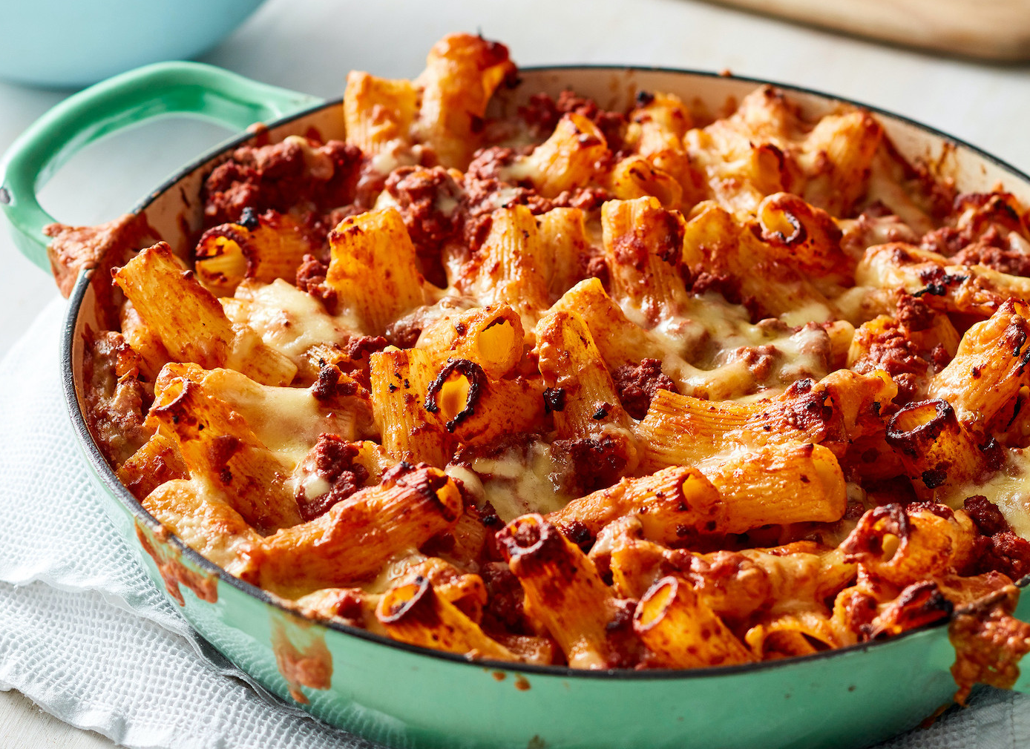
Week 3: Thursday
Red: Spaghetti Bolognese
Green: Bolognese Pasta Bake
Jacket Potato
Wrap
Beans, cheese or tuna
Ham, cheese or tuna

Slide 15
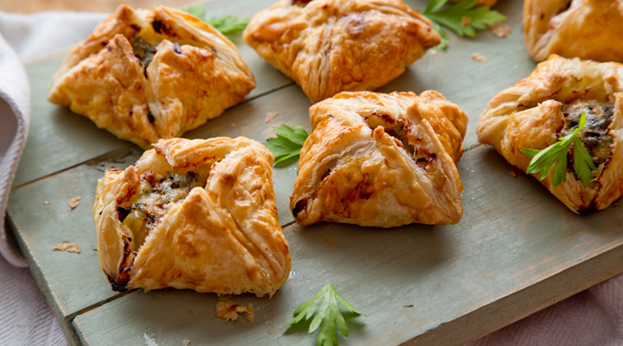
Week 3 - Friday
Red: Fish fingers, chips, beans and peas
Green: Leek Pastry Parcel
Jacket Potato
Roll
Beans, cheese or tuna
Cheese or tuna

