Slide 1
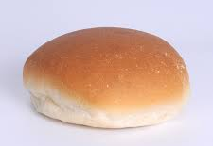
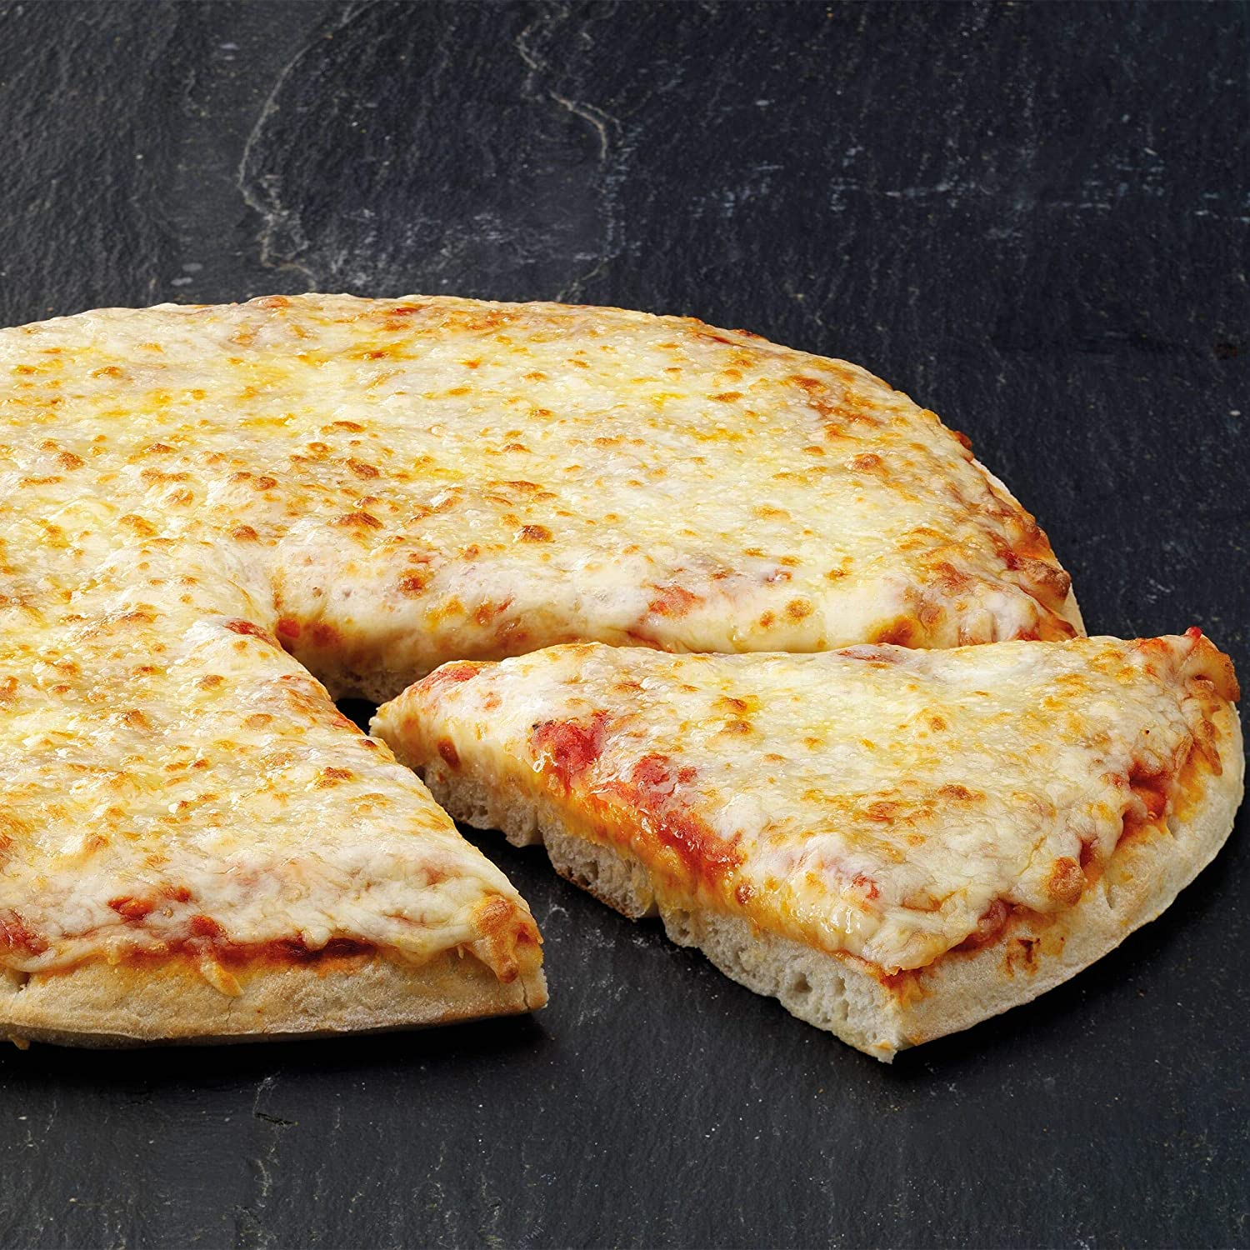
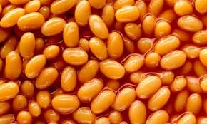
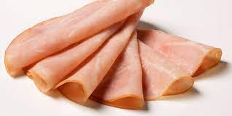
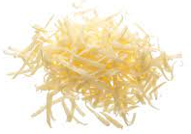
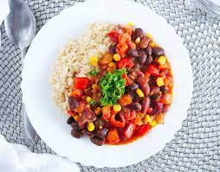
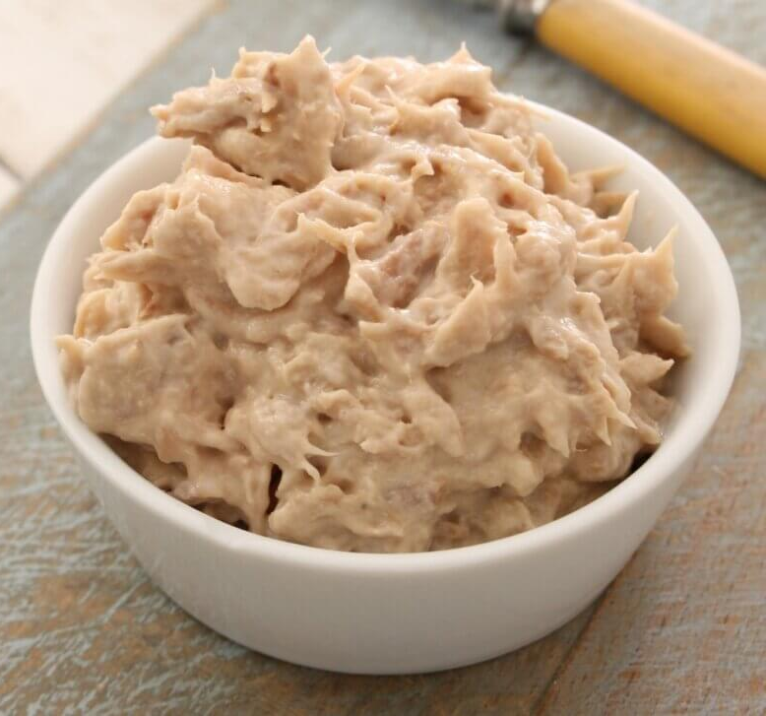
Week 1: Monday
Red: Margherita Pizza
Green: Five Bean Chilli
Jacket Potato
Roll
Beans, cheese or tuna
Ham, cheese or tuna

Slide 2
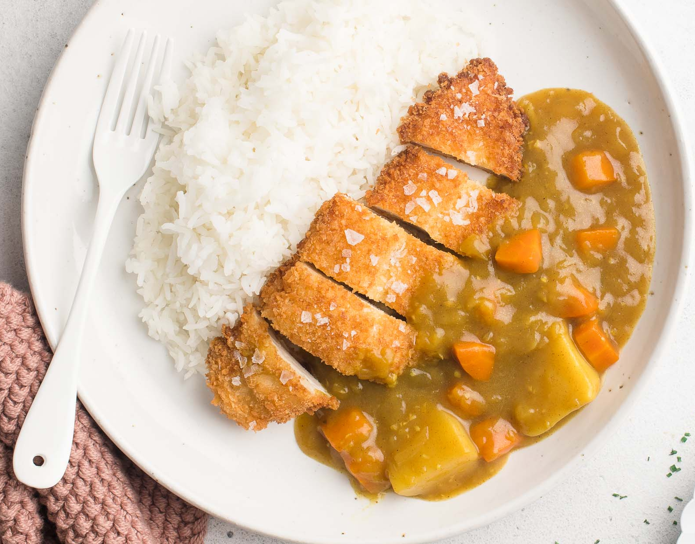
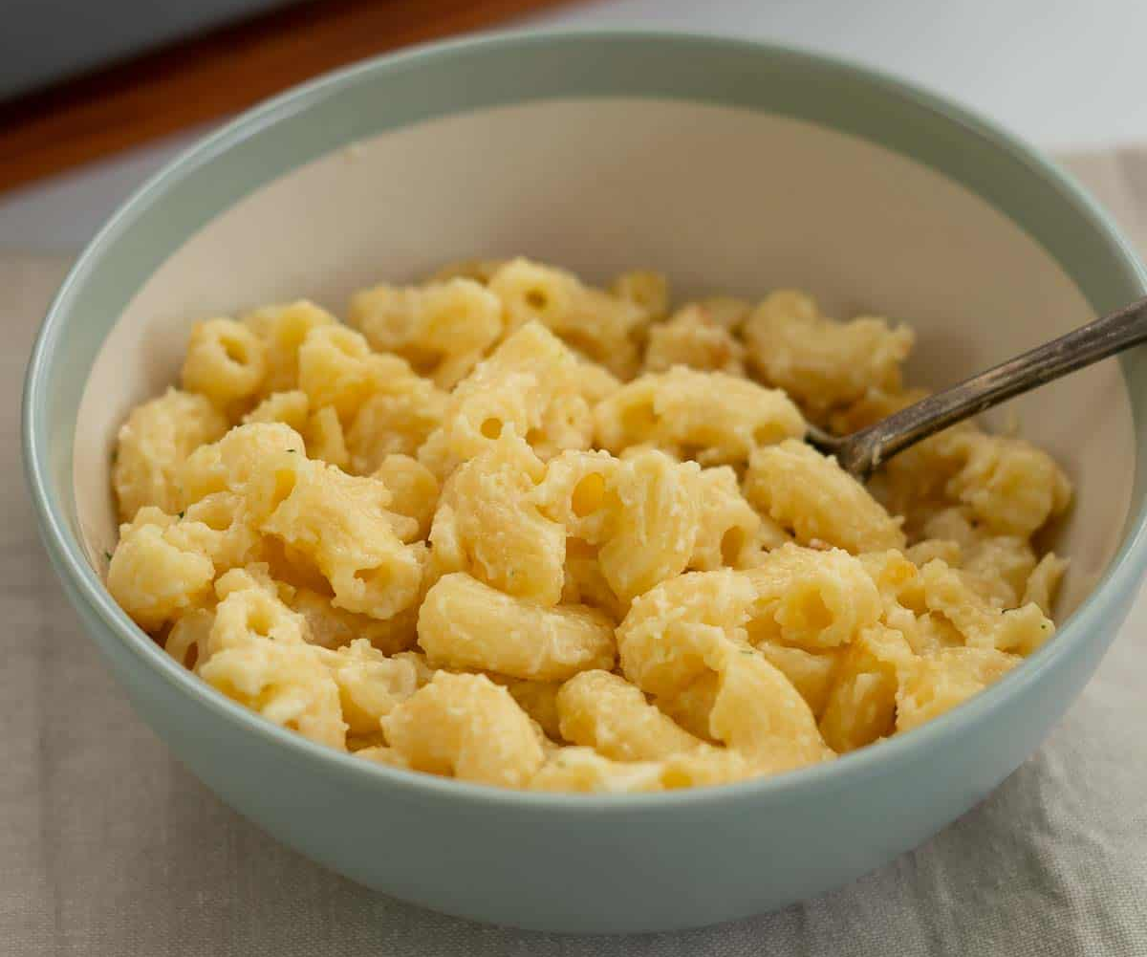
Week 1: Tuesday
Red: Chicken Katsu Curry
Green: Macaroni Cheese
Jacket Potato
Wrap
Beans, cheese or tuna
Ham, cheese or tuna

Slide 3
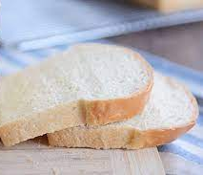
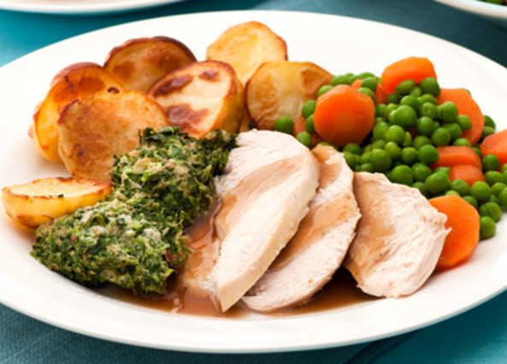
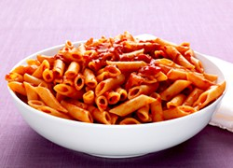
Week 1: Wednesday
Red: Roast Chicken
Green: Tomato Pasta
Jacket Potato
Sandwich
Beans, cheese or tuna
Ham, cheese or tuna

Slide 4
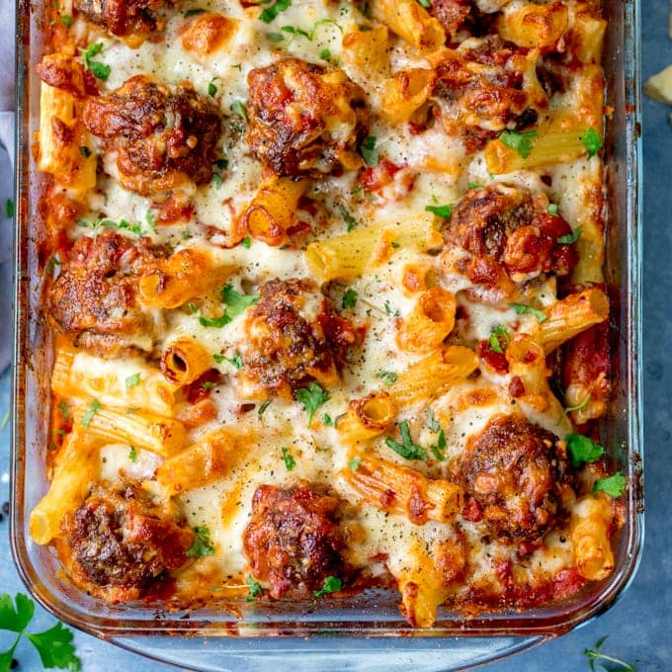
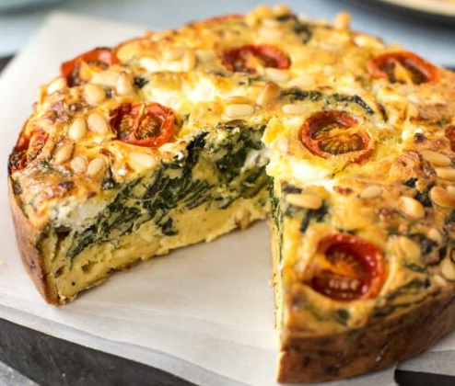
Week 1: Thursday
Red: Meatball and Tomato Pasta Bake
Green: Spanish Quiche and New Potatoes
Jacket Potato
Roll
Beans, cheese or tuna
Ham, cheese or tuna

Slide 5
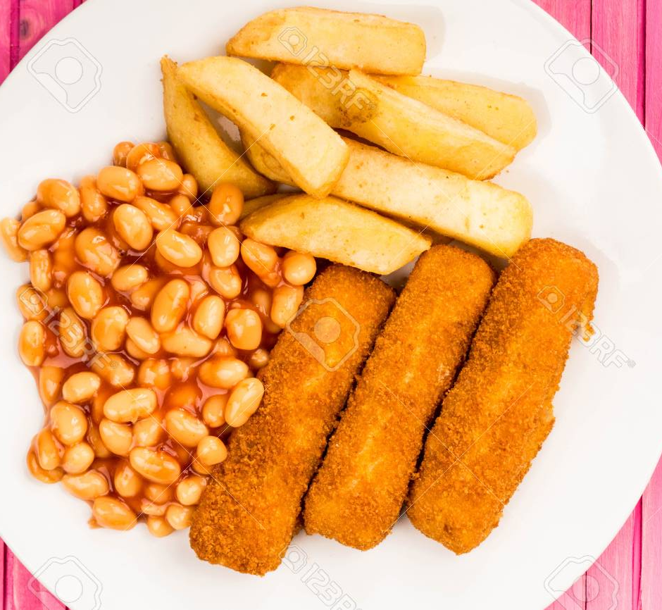
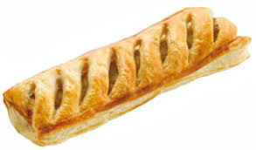
Week 1: Friday
Red: Fish Fingers
Green: Vegan Sausage Roll
Jacket Potato
Sandwich
Beans, cheese or tuna
Cheese or tuna

Slide 6
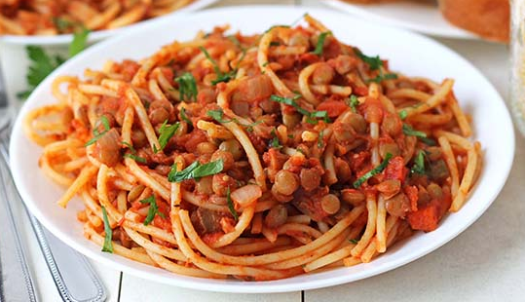
Week 2: Monday
Red: Margherita Pizza
Green: Plant Based Spaghetti Bolognese
Jacket Potato
Sandwich
Beans, cheese or tuna
Ham, cheese or tuna

Slide 7
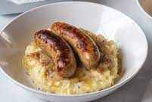
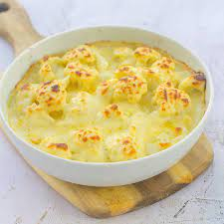
Week 2: Tuesday
Red: Sausages and Mash
Green: Cauliflower Cheese loaded
Yorkshire Pudding
Jacket Potato
Roll
Beans, cheese or tuna
Ham, cheese or tuna

Slide 8
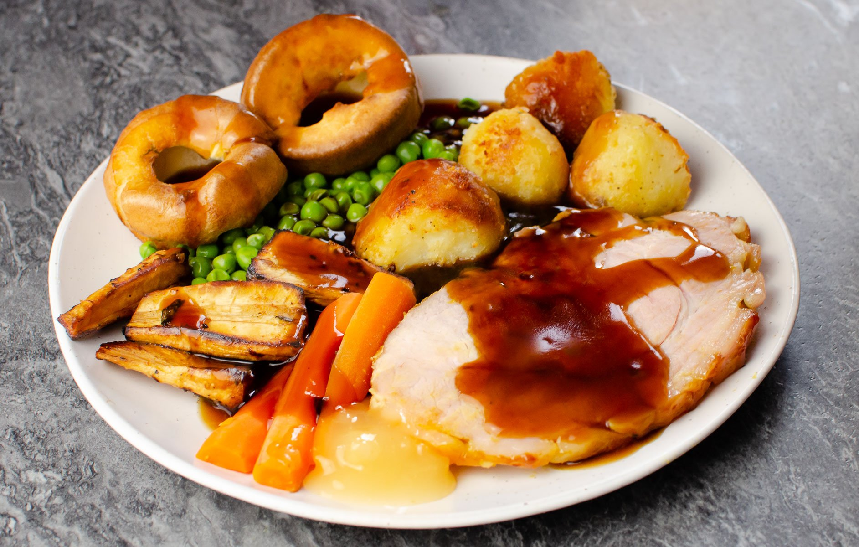
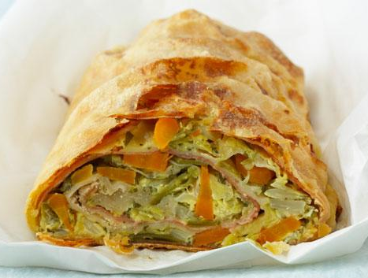
Week 2: Wednesday
Red: Gammon
Green: Seasonal Vegetable Strudel
Jacket Potato
Sandwich
Beans, cheese or tuna
Ham, cheese or tuna

Slide 9
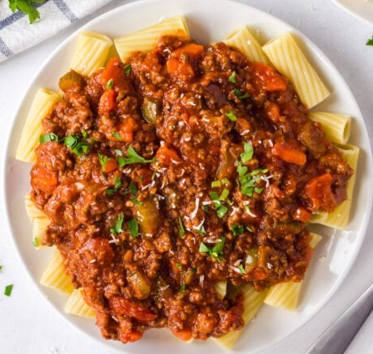
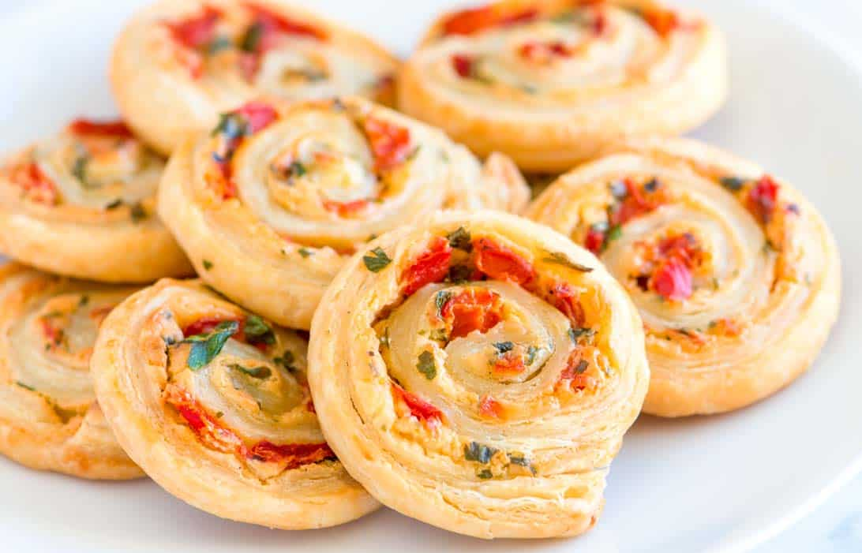
Week 2: Thursday
Red: Beef Pasta Bolognese
Green: Cheese and Tomato Pin Wheel
Jacket Potato
Wrap
Beans, cheese or tuna
Ham, cheese or tuna

Slide 10
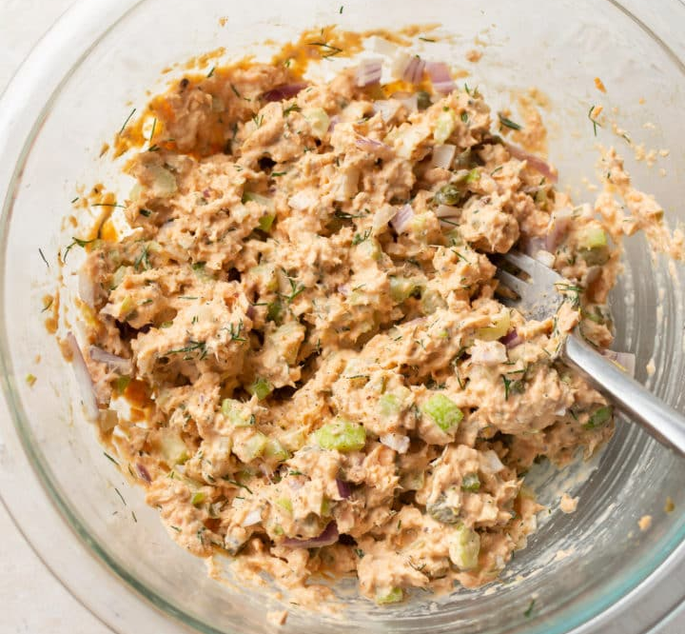
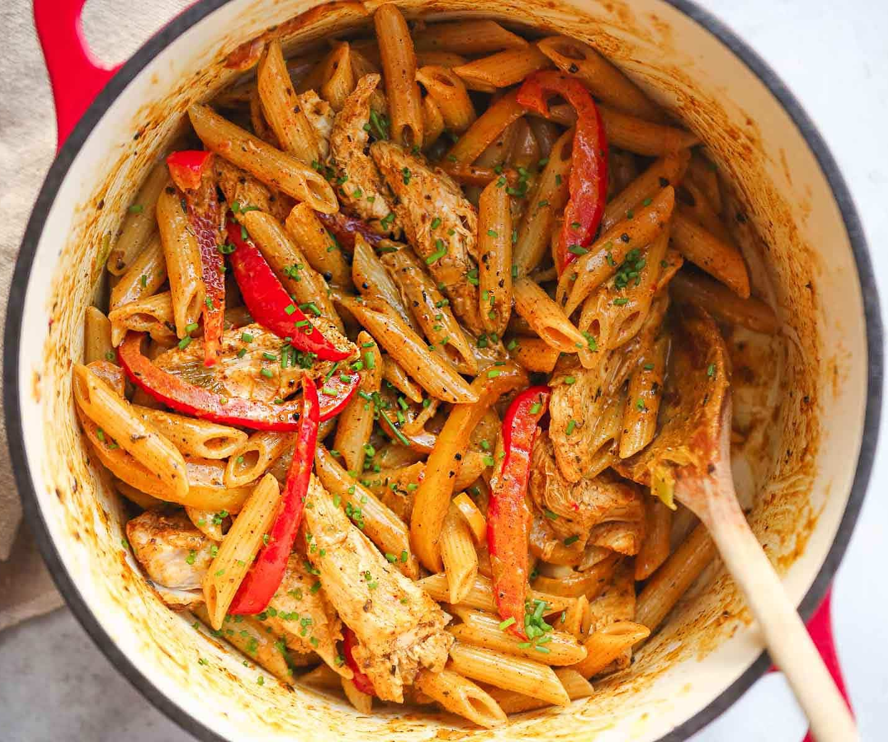
Week 2: Friday
Red: Fish Fingers
Green: Caribbean Pasta
Jacket Potato
Roll
Beans, cheese or tuna
Salmon, cheese or tuna

Slide 11
Week 3: Monday
Red: Margherita Pizza
Green: Pasta Neopolitan
Jacket Potato
Wrap
Beans, cheese or tuna
Ham, cheese or tuna

Slide 12
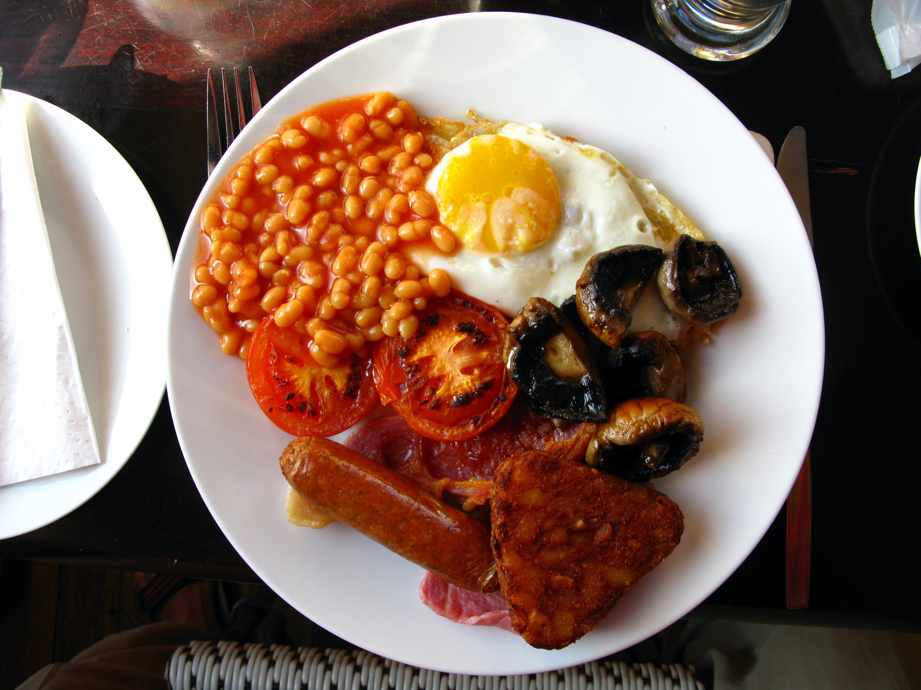
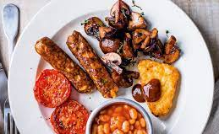
Week 3: Tuesday
Red: All Day Breakfast
Green: Veggie All Day Breakfast
Jacket Potato
Roll
Beans, cheese or tuna
Ham, cheese or tuna

Slide 13
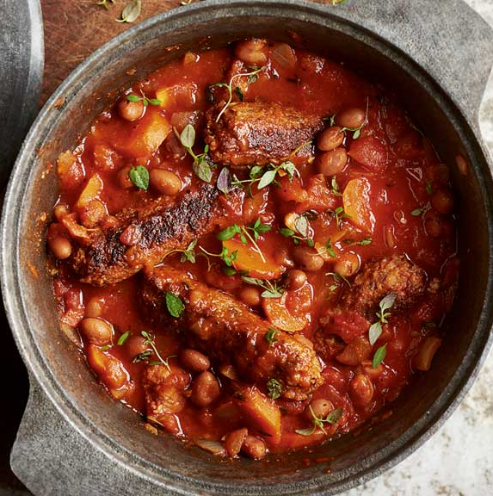
Week 3: Wednesday
Red: Roast Chicken
Green: Veggie Sausage Casserole
Jacket Potato
Sandwich
Beans, cheese or tuna
Ham, cheese or tuna

Slide 14
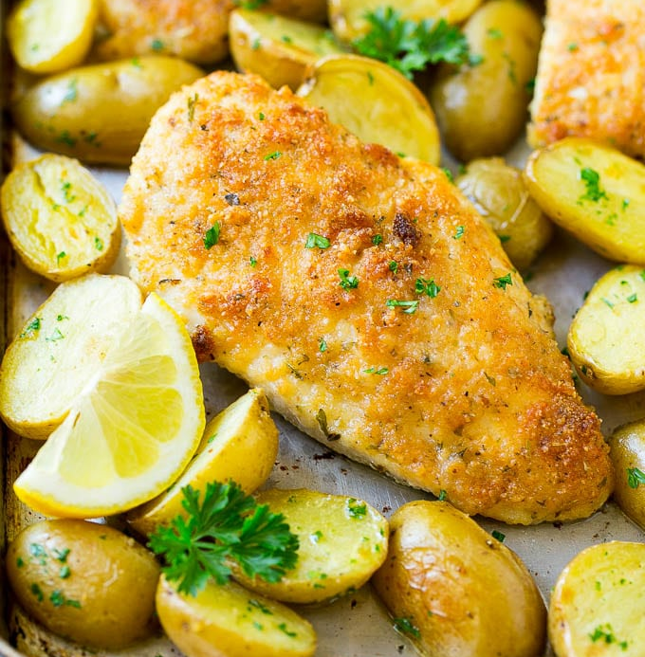
Week 3: Thursday
Red: Breaded Chicken
Green: Cheese and Sage Sausage Roll
Jacket Potato
Wrap
Beans, cheese or tuna
Ham, cheese or tuna

Slide 15
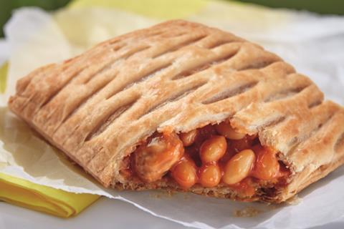
Week 3 - Friday
Red: Fish fingers, chips, beans and peas
Green: Baked Bean Melt
Jacket Potato
Roll
Beans, cheese or tuna
Cheese or tuna

