Slide 1
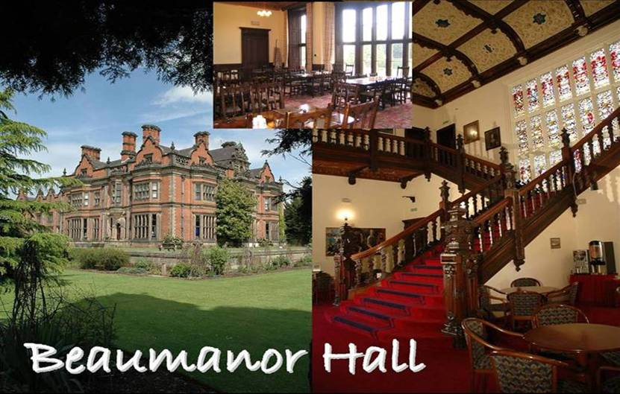
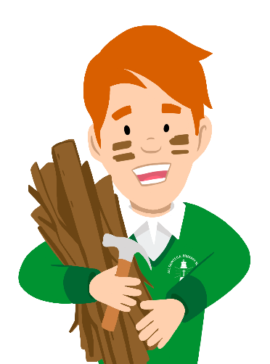

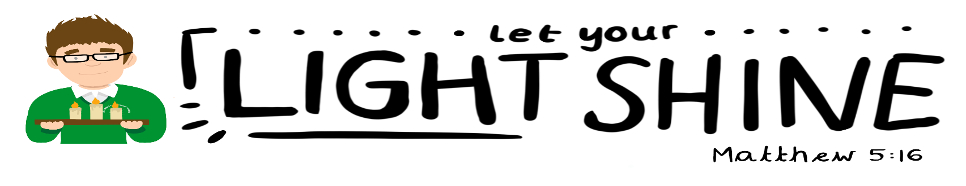
Beaumanor Outdoor Learning Centre
Notes:
Beaumanor Outdoor Learning Centre is Leicestershire County Council’s outdoor education provision.
Some views of the hall, showing the Victorian grandeur of the interior staircase. Also, a shot of the dining hall where the pupils will have their evening meals.

Slide 2
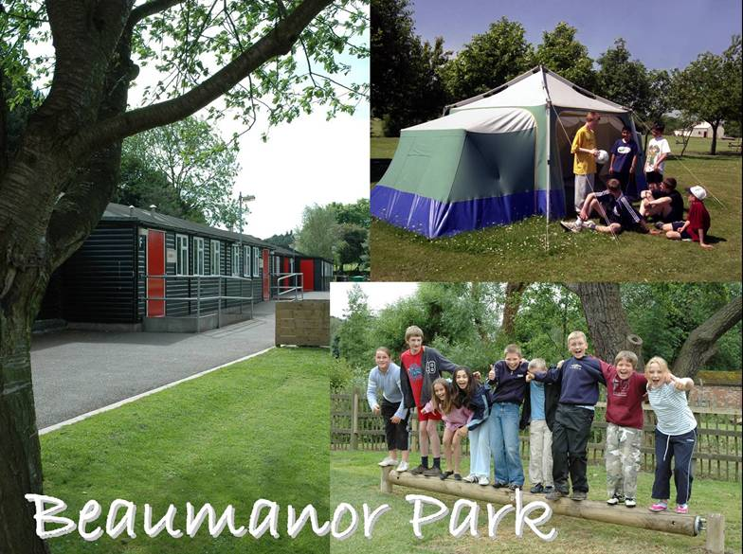
Notes:
Some views of the ‘Park’. A picture of the cabins and the grounds. Sometimes there are campers, so a standing camp is set up in the summer term.

Slide 3
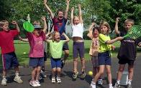
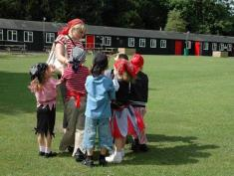
Residential Experience
SOME BENEFITS
Enrich the curriculum
Provide real life learning
Explore own potential
Increase self confidence
Team work and independence
Learn to manage risk
Notes:
The staff at Beaumanor believe passionately in the value of Outdoor Education and the benefits high quality outdoor learning can contribute to a young persons education. We will always try and work with schools to ensure the experiences we deliver to young people make a positive contribution to the school based curriculum.

Slide 4
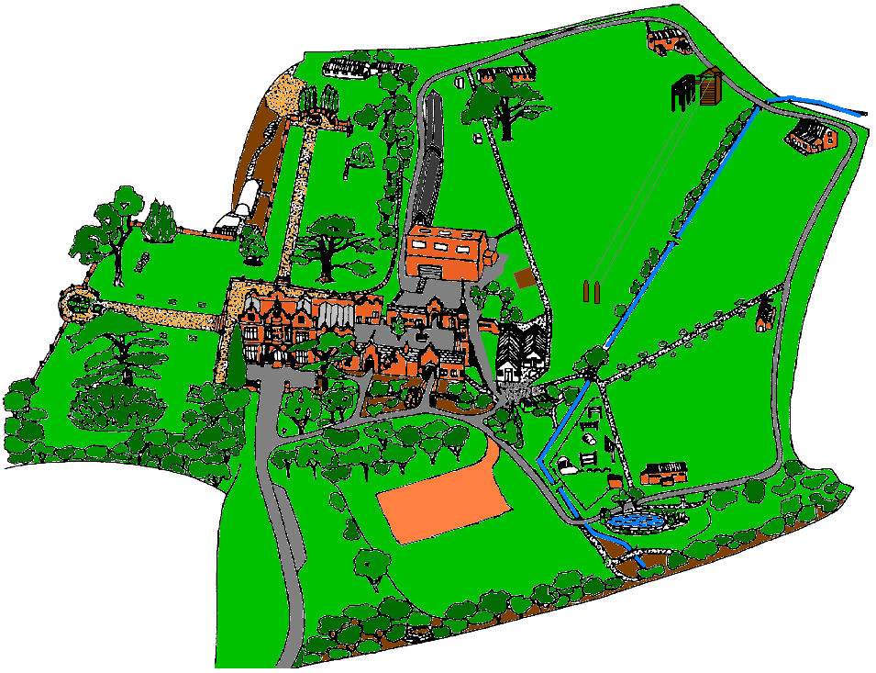
Orienteering
Notes:
We run a very successful orienteering/navigation activity that can be differentiated within any Key Stage.

Slide 5
Introduction Activities
Notes:
This is a series of team activities designed to familiarise the group with the staff, site and what lies ahead, preparing them for challenge, adventure, working together and fun.

Slide 6
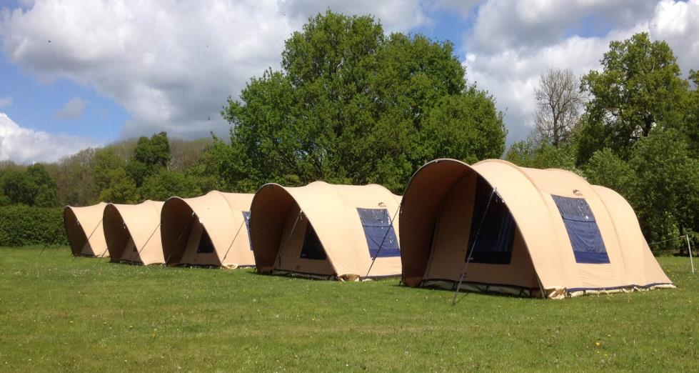
Arrival
Meet and greet Children arrive at 10.00 am
Monday 5th June
Escorted to tents
Booking in procedures explained
Children settle in
Children collected from Beaumanor at 1.30 pm
Wednesday 7th June
Notes:
Upon arrival, the group will be met off the coach. Their cabin will be available from 4pm onwards. Luggage storage areas and a classroom to eat their packed lunch in will be provided during the day. Please make sure the children arrive appropriately dressed and ready to start activities.

Slide 7
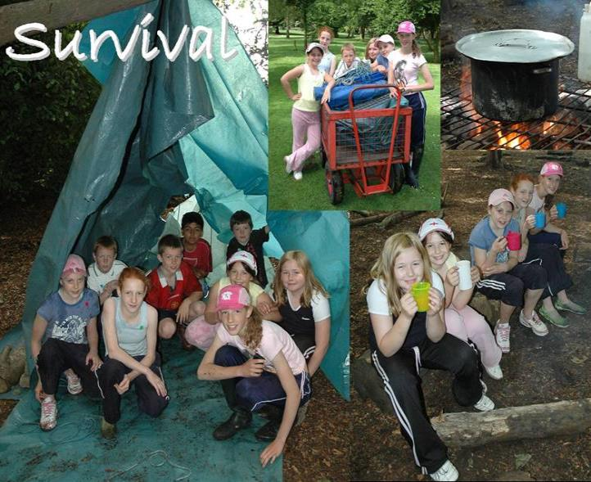
Problem Solving
Safety
Teamwork
Life skills
Knowledge
Achievement
Notes:
The children will be given the task of building a water-tight shelter in the woods at Beaumanor. Their instructor will throw a bucket of water on to their shelter to see how successfully the task has been completed. The activity calls upon students design skills and the ability to work as part of a team. The essentials for survival will be explored and how these requirements might be met.
They will then have some soup around a campfire.

Slide 8
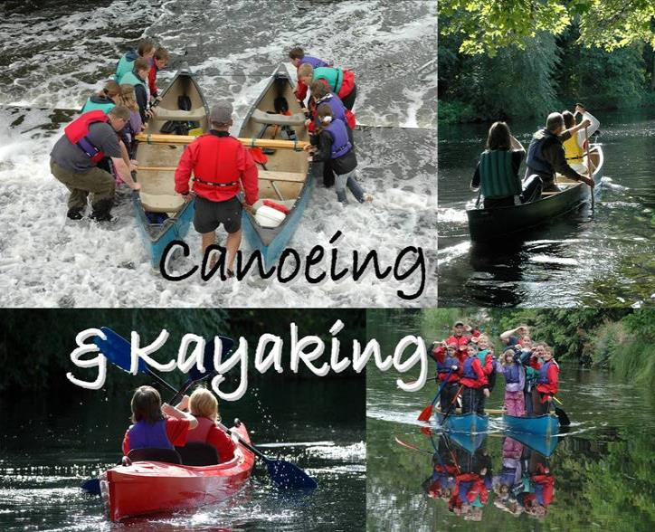
Technical skills
Knowledge
Teamwork
Journeying
Challenge
Notes:
Canoeing is now based back at Quorn Hall or in the event of the river being high, at Wanlip. You will be taken there by minibus.

Slide 9
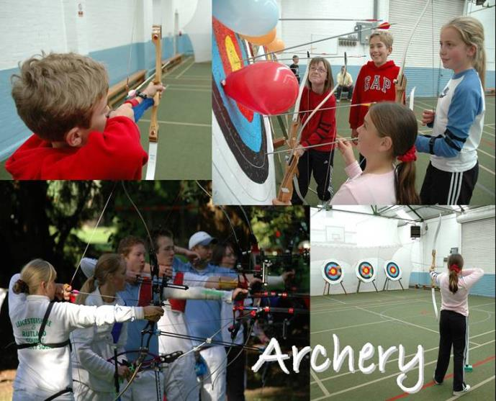
Technical skills
Knowledge
Games
Team competition
Life skills
Notes:
Beaumanor has both indoor and outdoor archery ranges.
All instructors have been CRB checked. All instructors have relevant National Governing Body qualifications to be able to deliver the adventure activities.
The activities your children will do:
Archery

Slide 10
Safety
Personal Challenge
Life skills
Thrill
Achievement
Notes:
The young people ( and group leaders!) will be encouraged to attempt the aerial trek, an obstacle course 6 metres off the ground, and have a go on the zip wire. This is an exhilarating experience and the participants will gain a great sense of personal development from this.

Slide 11
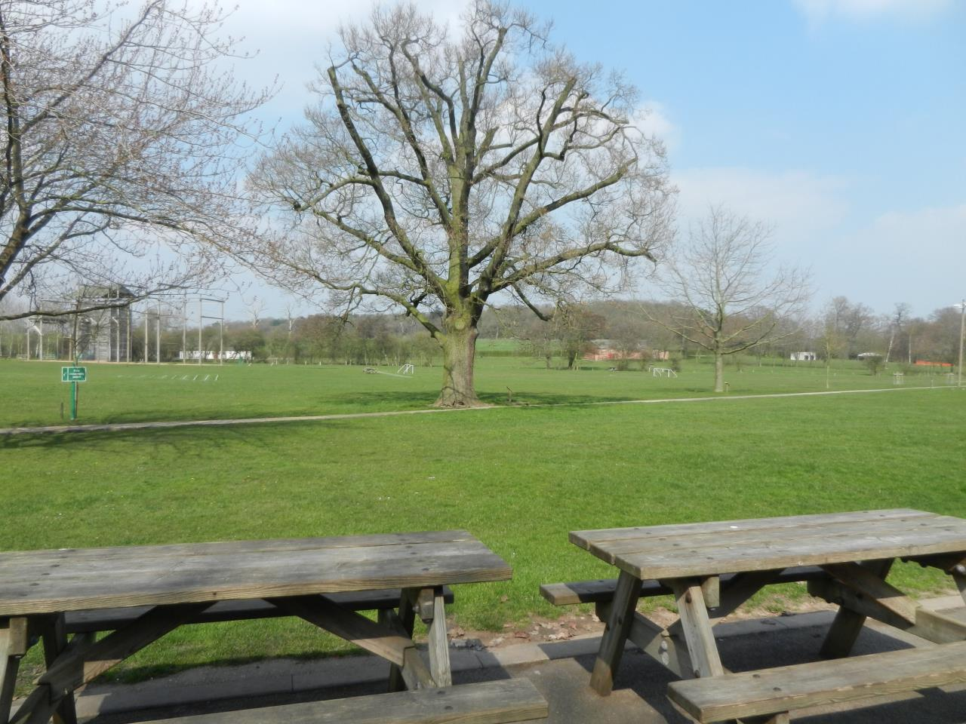
Residential kit
Sleeping bag
Pillow
Toiletries
Towel
Nightwear
Underwear
Torch
Indoor shoes
Sun cream
Plastic bags!!!
Gift shop money
Notes:
Suncream:- we recommend factor 30 as a minimum requirement.
A rucksack is a good way to carry the sleeping bag – pack sleeping directly into the rucksack.

Slide 12
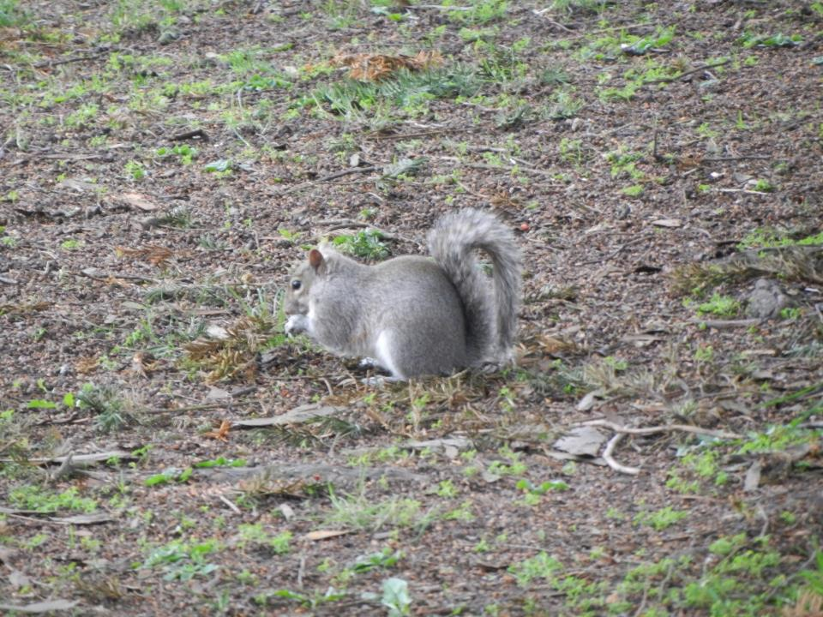
Kit for activities
Tracksuit bottoms
Thermal / football tops / shorts
Sweatshirt / fleece
Waterproof jacket / trousers
Hat
Old trainers
Wellies
We provide personal protective equipment
Notes:
Recommended kit. No jeans for activities. They hold water when wet and do not dry off quickly enough.
No expensive clothing or fashion items. The clothes will get dirty, muddy, wet and smelly so old or not so special clothes are best
All specialist equipment is provided such as helmets and harnesses and children are shown how to put them on. Instructors always check that it is fitted correctly before the children start any activities.

Slide 13

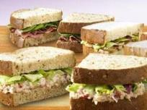
Mealtimes
Breakfast:
Cereals
Toast
Juice
Cooked breakfast
Lunch:
Sandwich
Cake
Fruit
Juice
Notes:
Lunch is a pack up, usually taken in or near the cabin, depending on the weather. There are picnic tables outside the cabins, plus the children are more than welcome to sit on the grassed areas.

Slide 14
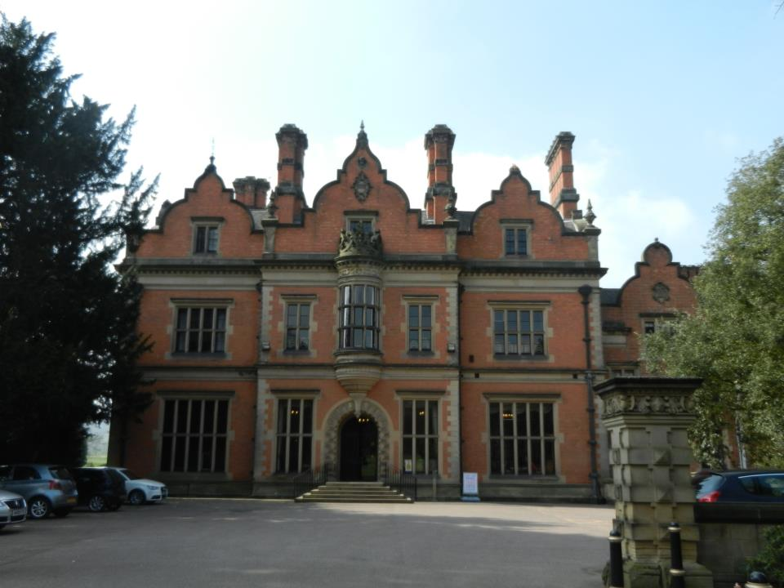
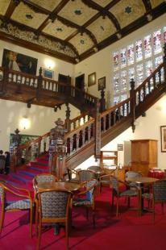
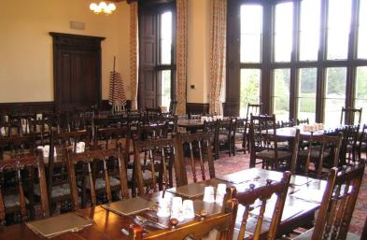
Mealtimes
Evening meal
  Sausage & Mash/veggie sausage
  Quorn Dippers/Chips
  Pizza(veggie)
  Pork Meatballs/Vegan Meatballs
  Salad bar
  Sponge/Flapjack/Cookies/Ice Cream
  Jacket Potatoes
  Yoghurts/fruit
Notes:
Evening meals will vary from any of the above selection.
There is always plenty of food.

Slide 15
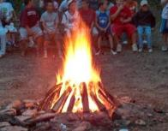
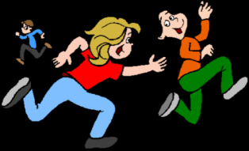
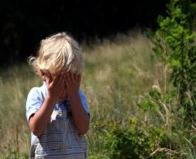
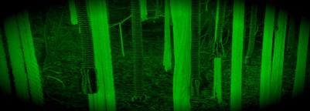
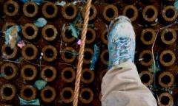
Evening activities
Cellars – Hide and Seek
Night Line
Notes:
There is a small selection of evening activities form which the school will have selected:
Murder Mystery:
The group will do MM around the site, looking for clues to solve a mystery, inspired by the Victorian history of the house.
Cellars:
The group will play ‘Hide and Seek’ in the cellars. The session starts with some lights on, which are gradually dimmed. This activity enables children to overcome a fear of the dark This activity is usually a highlight of the trip.
Gym Games:
The children will play a selection of sport games in the gym or on the field – light and weather depending!
Campfire:
The children will sit around a campfire and play a few games. Visiting staff are more than welcome to lead singing round the campfire!
Night Line:
The night line is a rope trail running through our beautiful woodlands across numerous man-made obstacles. Participants follow the course blindfolded, meaning that other senses (and perhaps good communication from a sighted helper) must be relied upon to enable a safe and successful circuit of the course.

Slide 16
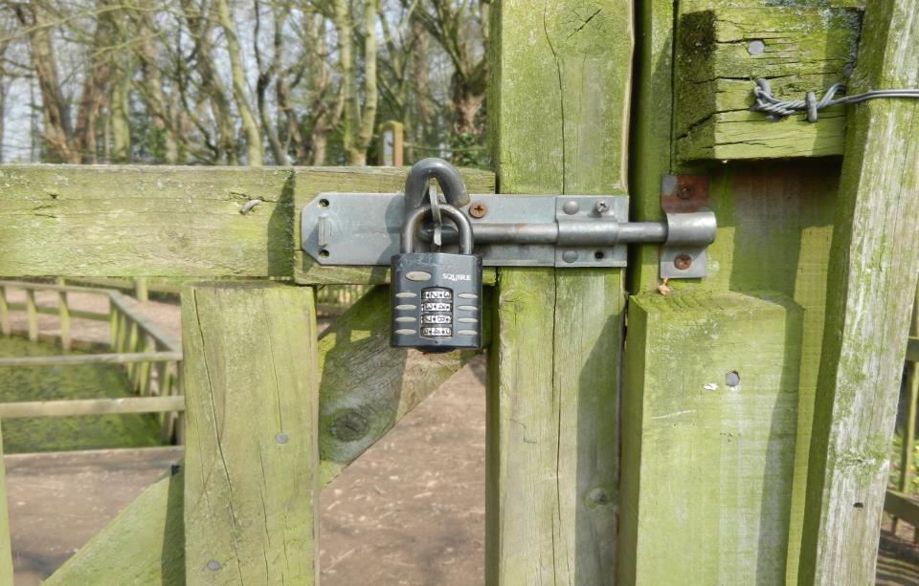

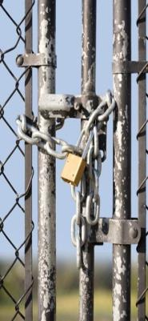
Security
Private Site: Boundary fenced
Locked gate
24hrs Duty Team Member
Notes:
Cabin doors – once locked, there is no access from the outside, but those inside can still get out, as there are push bars on the doors.
The cabin doors have alarms which can be set at night-time.
Windows have a safety catch so that they can only be opened a little way.
The main site gate is locked at about 8:30. The group’s leader is issued with the security code, should they need to leave the site or allow someone, eg a parent, in.
They are also given the phone number of the duty person, should they need to call if there are any problems.

Slide 17



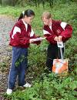
Learning Outside the Classroom experiences
    Safe
    Fun
    Investigation
    Exploration
    Journeying
    Adventure
    Residential
Notes:
Beaumanor OLC is accredited by both the Council for Learning Outside the Classroom and AALA. All risk assessments and staff competence are scrutinised by outdoor education experts from both authorities.
OLS programmes support and develop Learning Outside of the Classroom experiences
Above else safety takes precedence.
Beaumanor should be fun and memorable from which lasting and treasured memories are taken away.
Play – during and between activities, learning how to play effectively with other people
Investigation - through the problem solving tasks they will do
Exploration – by getting to know their new surroundings, including the river during the canoeing activity
Journeying – preparing for the trip, safe behaviour on the coach to + from Beaumanor, safe behaviour on the minibus from one centre/ location to another
Adventure – through the activities
Residential – by being away from home for a few days.
They will gain a big sense of personal development on this trip.

Slide 18


Any questions?
Notes:
Beaumanor Outdoor Learning Centre is Leicestershire County Council’s outdoor education provision.
Some views of the hall, showing the Victorian grandeur of the interior staircase. Also, a shot of the dining hall where the pupils will have their evening meals.

